Slide 1
SUPPLY BRAIN · CHARTER PHASE 3 DELIVERABLE
Price Elasticity & Buffer Strategy Routing
Findings, method, and the price–inventory exchange rate
Rerun on repo commit 8301f25 (origin/main, pulled 2026-09-01) | 303,359 2025 order lines · 500 SKUs | prepared by N. Sunnel, 2 Sep 2026

Slide 2
EXECUTIVE SUMMARY
Four findings
• All five categories are price-elastic (|β₁| from 1.06 to 3.60). Frozen Foods and Snacks & Confectionery are highly elastic; Beverages is the least.
• Elasticity must be read at segment level, not category — Dairy & Bakery splits from elastic (Premium ≈ −1.7) to statistically flat (Value ≈ −0.3).
• The price–inventory exchange rate favours INVENTORY for four of five categories; Frozen Foods is the only break-even case (1.23×).
• Portfolio-wide exchange rate ≈ 0.33× — $1 of discount-driven buffering offsets only ~33¢ of inventory carrying cost, at MEIO’s safety-stock levels.
Portfolio exchange rate 0.33×
inventory carrying cost $374,841/yr vs equivalent price-buffer cost $1,138,878/yr

Slide 3
SCOPE
What the charter asked for
“For each segment, estimate price elasticity and compare the cost of buffering with inventory vs. buffering with price… The system quantifies the exchange rate: $1 of price flexibility = $Y of safety stock — a comparison no existing supply chain system makes systematically at SKU level.”
• How does demand respond to price — by category, and by finer segment?
• Is that response in line with published FMCG norms (a check that the model is sound)?
• Per segment: what does $1 of price flexibility buy you in avoided safety-stock cost?

Slide 4
METHOD
The elasticity model
• Constant-elasticity (log–log) demand curve with two-way fixed effects:
  – ln(qty) = β₀ + β₁·ln(base_price) + β₂·ln(1 − discount) + α(sku) + γ(period) + ε
• β₁ = elasticity to shelf/list price · β₂ = response to promo depth (negative ⇒ discounts lift volume).
• SKU and ISO-week fixed effects are demeaned out first, so the coefficient is within-SKU, within-week price response — not the fact that cheap SKUs sell in bigger unit counts.
• Estimator reproduces segmentation_v2.py §2 exactly, then adds HC1 robust standard errors for confidence intervals.
• Exchange rate: price the MEIO-recommended safety stock two ways —
  – inventory cost = SS$ × (holding% + capital%) | price cost = |ΔQ% ÷ elasticity| × avg_price × annual_volume
  – exchange rate = inventory cost ÷ price cost (<1 ⇒ inventory cheaper)

Slide 5
INPUTS
Data & provenance
Item | Value
Repo commit | 8301f25 (origin/main, pulled 2026-09-01)
Data window | 2025-01-06 → 2025-12-31 (2025 actuals only)
Order lines | 303,359
SKUs / categories / price tiers | 500 / 5 / 2
Lines carrying a discount | 5.7% (max depth 35%)
Elasticity inputs | orders.csv, sku_master.csv
Exchange-rate inputs | cost_parameters.csv, models/MEIO/output/meio_summary_by_category.csv
Notebook | Price Elasticity/price_elasticity_analysis.ipynb
Only ~5.7% of lines carry price variation, so β₁ leans on modest within-SKU list-price drift — a real precision constraint (see Caveats).

Slide 6
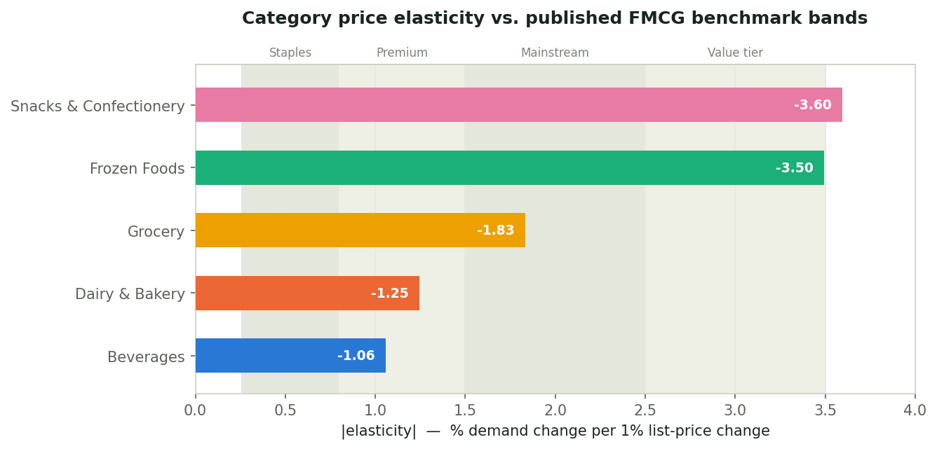
FINDING 1
Category-level price elasticity
• Frozen Foods & Snacks ≈ −3.5: shoppers switch sharply on price.
• Beverages least elastic (−1.06) — sits in the premium band; portfolio skews to differentiated SKUs (spirits, specialty tea), not commodity drinks.
• Grocery is textbook mainstream FMCG (−1.83).
• All coefficients negative, p ≈ 0, tight CIs.

Slide 7
FINDING 1 · DETAIL
Regression output by category
Category | β₁ list price | SE | 95% CI | β₂ promo | R² | n
Snacks & Confectionery | -3.60 | 0.130 | [-3.85, -3.34] | -3.57 | 0.060 | 62,286
Frozen Foods | -3.50 | 0.132 | [-3.75, -3.24] | -3.50 | 0.062 | 55,970
Grocery | -1.83 | 0.130 | [-2.09, -1.58] | -2.23 | 0.020 | 62,963
Dairy & Bakery | -1.25 | 0.138 | [-1.51, -0.98] | -2.43 | 0.026 | 60,820
Beverages | -1.06 | 0.135 | [-1.32, -0.79] | -1.35 | 0.008 | 61,320
R² is low across the board (0.008–0.062): price explains only a sliver of order-to-order quantity variation on this synthetic data.
The reliable outputs are the sign, the ordering, and the rough magnitude — not the third decimal.

Slide 8
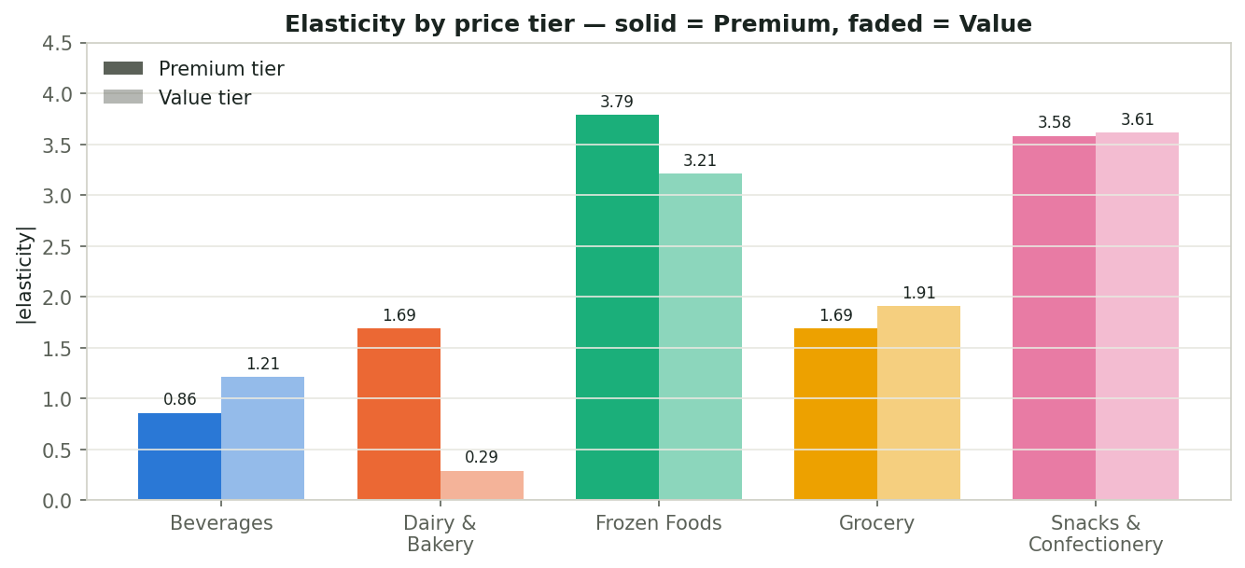
FINDING 2
Segment split: category × price tier
• Dairy & Bakery is the case segmentation exists for:
  – Premium ≈ −1.7 (genuinely elastic)
  – Value ≈ −0.29, p = 0.21 — not distinguishable from zero
• A blanket category discount would waste margin on Value SKUs that don’t respond.
• Frozen & Snacks are uniformly elastic in both tiers; Beverages shows a milder split.

Slide 9
VALIDATION
Benchmark sanity-check
Category | β₁ (base) | Nearest published band | In a published range?
Snacks & Confectionery | -3.60 | more elastic than value-tier band | Yes
Frozen Foods | -3.50 | Value tier / private label | Yes
Grocery | -1.83 | Mainstream FMCG | Yes
Dairy & Bakery | -1.25 | Premium / differentiated | Yes
Beverages | -1.06 | Premium / differentiated | Yes
• Elasticity is derived from real discount variation, not assumed — but still cross-checked against published FMCG ranges.
• Every category lands inside a recognised band. No wrong signs, no implausible magnitudes (|β| > 5), no positive coefficients. The model behaves.

Slide 10
FINDING 3 · CONCEPT
The price–inventory exchange rate
• Question: for each category, is it cheaper to absorb demand uncertainty with safety stock, or with price flexibility (a discount that pulls demand in on demand)?
• Fixed quantity of protection = the safety stock MEIO already recommends (nothing fabricated).
• Inventory cost = optimized SS$ × (holding cost % + cost of capital %)
• Price cost = discount depth needed × average price × annual category volume
  – where discount depth needed = | (SS in units / annual volume) ÷ elasticity |
• Exchange rate = inventory cost ÷ price cost
  – < 1 → inventory is the cheaper buffer > 1 → price flexibility is cheaper
• Discount is modelled as hitting all baseline volume — the standard category-promo assumption.

Slide 11
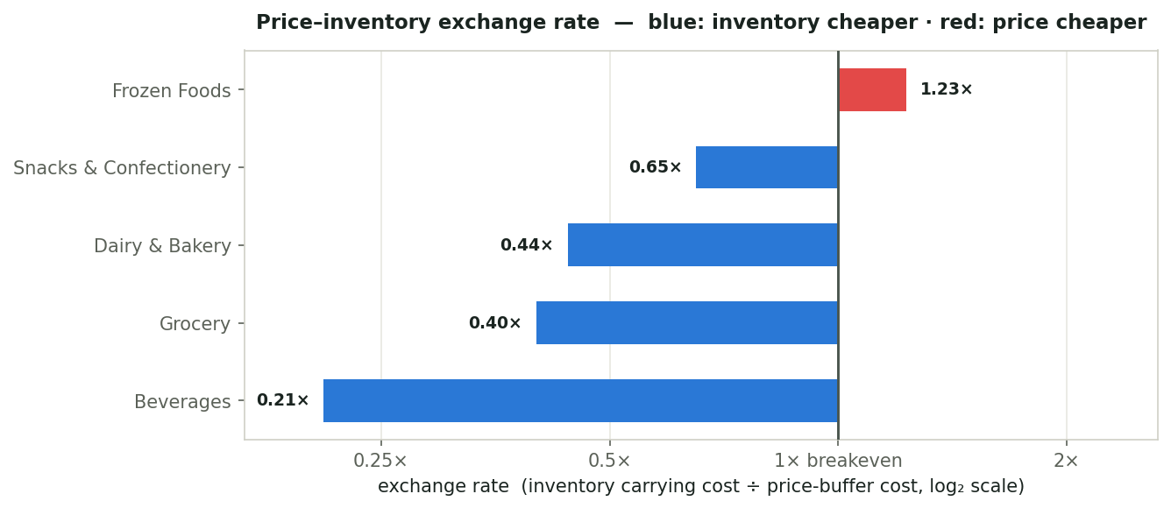
FINDING 3 · RESULTS
Exchange rate by category
Category | Elast. | Inv $/yr | Disc. | Price $/yr | Rate
Frozen Foods | -3.50 | $51,727 | 0.52% | $42,056 | 1.23×
Snacks & Confectionery | -3.60 | $75,086 | 0.49% | $115,215 | 0.65×
Dairy & Bakery | -1.25 | $40,112 | 1.07% | $91,086 | 0.44×
Grocery | -1.83 | $42,797 | 0.72% | $106,963 | 0.40×
Beverages | -1.06 | $165,119 | 1.09% | $783,558 | 0.21×
Inventory wins 4 of 5. Frozen Foods is the sole
break-even (1.23×): high elasticity + low ticket
price ($5.95) + small SS base vs throughput.
Beverages worst (0.21×): $36 price × ~2M units.

Slide 12
FINDING 3 · WHY
Elastic ≠ cheap-to-buffer-with-price
THE BASE-RATE EFFECT
Safety stock is only ~1–1.6% of a category’s annual volume. But the discount needed to pull in that 1–1.6% is paid on ALL the volume. Carrying cost is paid only on the buffer units themselves. So even a highly elastic category needs a broad, expensive discount to match a cheap physical buffer.
WHERE THE EXCEPTION SHOWS UP
Frozen Foods breaks even: elasticity −3.50, but a low average price ($5.95) and a smaller safety-stock base relative to throughput mean a small discount goes far. Beverages is the opposite — $36 average price across ~2M units makes even a 1.1% discount dwarf the cost of just holding the stock.

Slide 13
RECOMMENDATION
Buffer-mix starting point per segment
Category | Rate | Recommended buffer strategy
Frozen Foods | 1.23× | Trial a 25–50% price-buffer blend — closest to parity, highly elastic, low ticket price.
Snacks & Confectionery | 0.65× | Inventory-led; use price as a secondary lever, mainly on the Value tier.
Grocery | 0.40× | Inventory-led. Reserve price moves for clearance / write-off avoidance.
Dairy & Bakery | 0.44× | Inventory-led. Treat Premium and Value tiers as different SKUs — Value does not respond to price.
Beverages | 0.21× | Inventory-led. Price is the most expensive buffer here by a wide margin.
All routing is anchored to MEIO’s optimised safety stock. Against the pre-optimisation policy the inventory side is ~60% larger, which shifts the rates but not the ranking.

Slide 14
CAVEATS & NEXT STEPS
What would sharpen this
• Model R² is low (0.008–0.062) — trust the sign / ordering / magnitude, not the point estimates.
• Thin price variation: only ~5.7% of lines carry a discount (max 35%). Value-tier Dairy & Bakery comes back statistically insignificant.
• Uniform-discount assumption inflates the price-buffer cost. Targeted / dynamic pricing (the charter’s agentic layer) would discount only the at-risk slice and move every rate toward price.
• One year of actuals — a second year separates seasonal price patterns from true elasticity.
• One-shot estimate. The Obsidian research track proposes a self-recalibrating exchange rate via a multi-armed bandit over buffer-mix arms — a stronger version of the same deliverable.
• Exchange rate is anchored to MEIO’s optimised safety stock (not the current policy).
Source notebook: Price Elasticity/price_elasticity_analysis.ipynb · artefacts: Price Elasticity/output/

